Slide 1
Introduction to Manual Testing

Slide 2
What is Software Testing?
It is a method to check whether the actual software product matches expected requirements and to ensure that software product is Defect free. It involves execution of software/system components using manual or automated tools to evaluate one or more properties of interest. The purpose of software testing is to identify errors, gaps or missing requirements in contrast to actual requirements.

Slide 3
Benefits of Software Testing
Cost-Effective
Security
Product quality
Customer Satisfaction

Slide 4
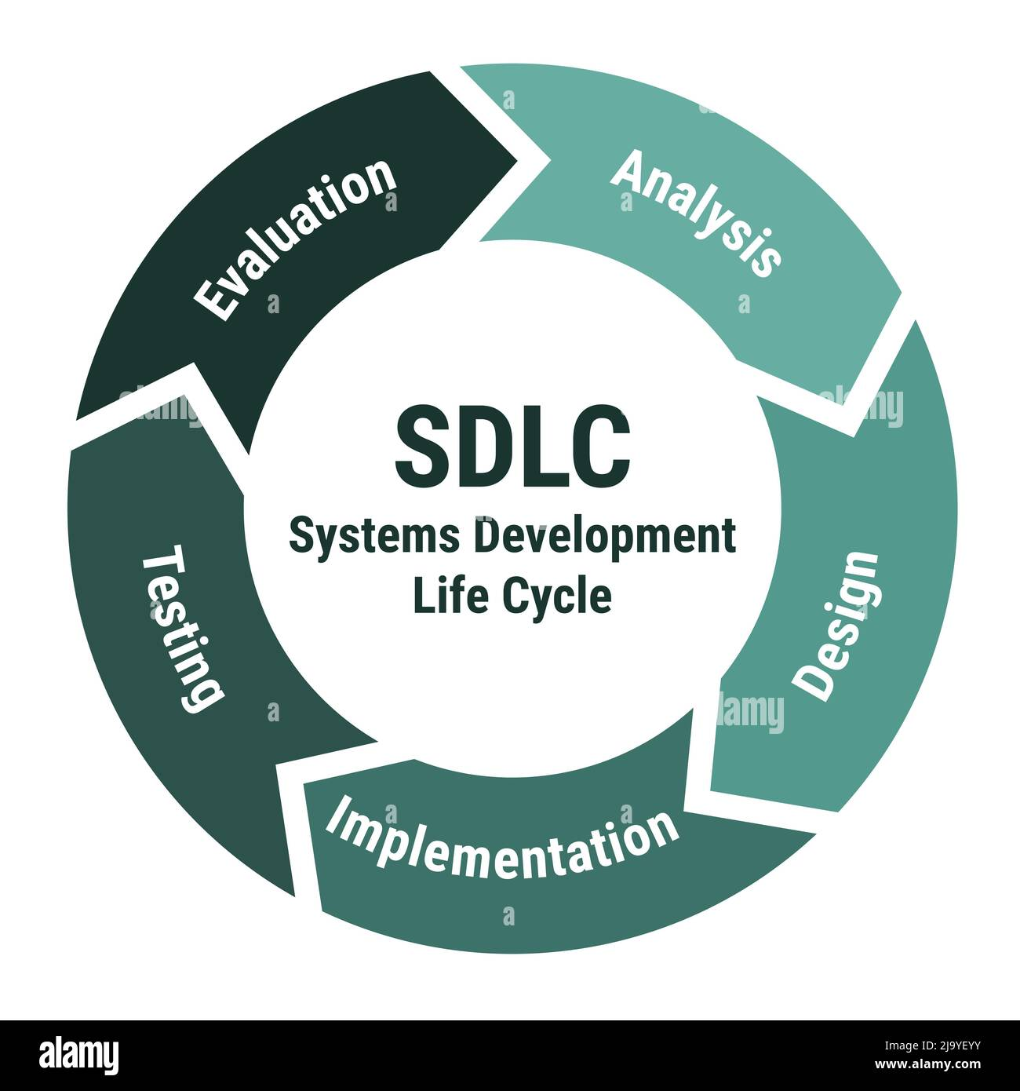

Slide 5
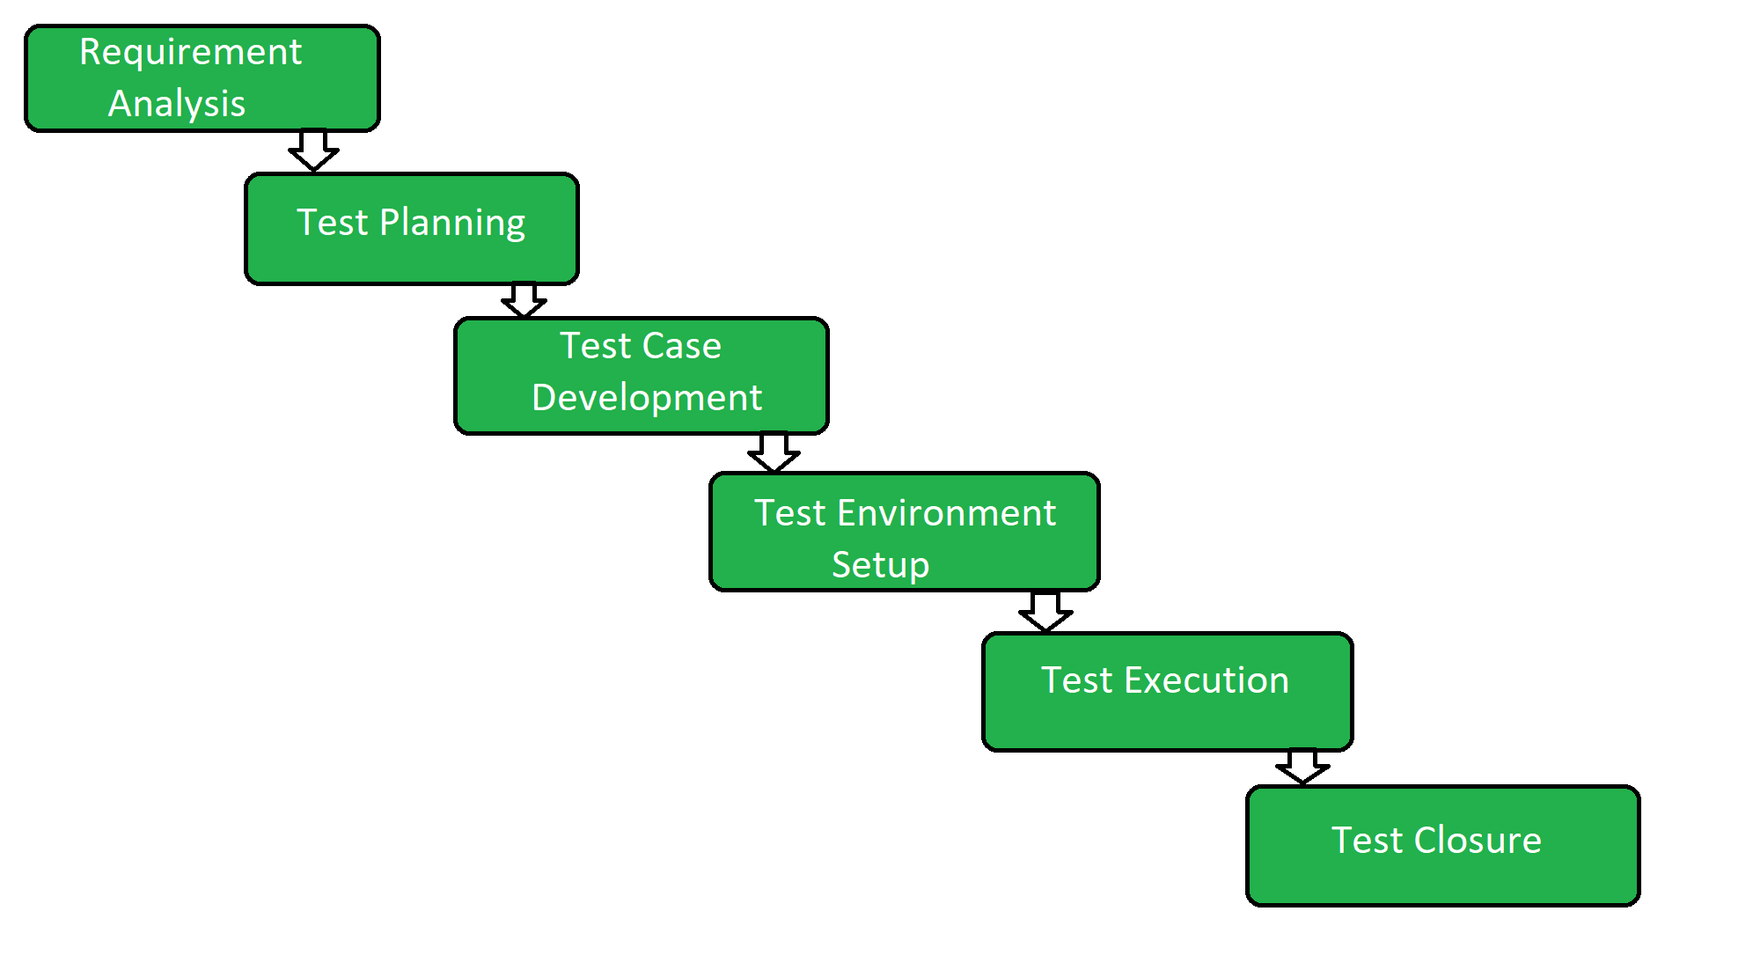
STLC (Software Testing Life Cycle)

Slide 6
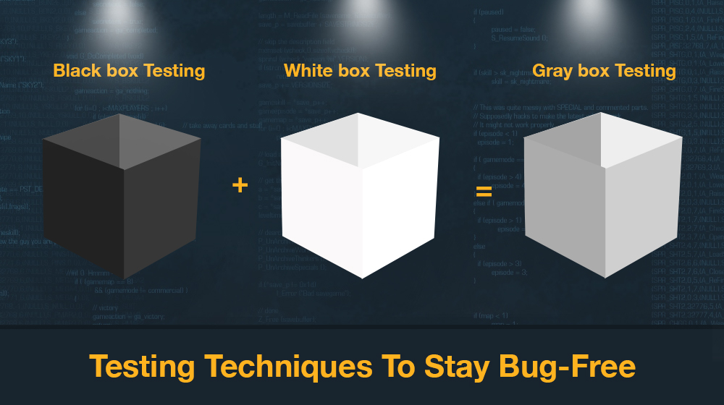
Types of Testing Methodologies

Slide 7
Gray Box Testing Example
Let’s use a simple example of a hyperlink on a webpage to understand how gray box testing works and how it differs from the other types of software testing.
In gray box testing, the tester may start by clicking the hyperlink to check whether it opens a new page. The tester would then check if the HTML code is pointing to the correct URL using the correct syntax. Finally, the tester rechecks the user interface to confirm that the browser redirects them to the correct URL.
If the tester were performing white box testing, they would only check if the HTML is coded properly and it points to the correct URL using the correct syntax. In black box testing, they would only click the hyperlink and check if the browser redirects them to a new URL.

Slide 8
Methodologies in Software Testing
Functional - Smoke Testing (BVT, BAT), Sanity Testing, Regression, Unit Testing, Integration Testing, Feature Testing, System Testing etc
Non- Functional Testing - Performance Testing- Load Testing, Stress Testing, Spike Testing, Volume Testing etc

Slide 9
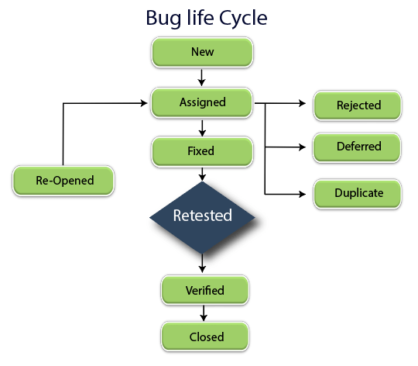

Slide 10
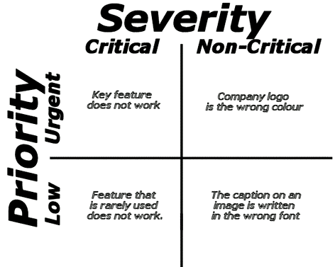

Slide 11
Test Case Design Techniques
Error Guessing
Equivalence Partitioning
Boundary Value Analysis
Decision Table
State Transition

Slide 12
Test Case
A test case refers to the actions required to verify a specific feature or functionality in software testing. The test case details the steps, data, prerequisites, and postconditions necessary to verify a feature.
The Objective of Writing Test Cases
To validate specific features and functions of the software.
To guide testers through their day-to-day hands-on activity.
To record a catalog of steps undertaken, which can be revisited in the event of a bug popping up.
To provide a blueprint for future projects and testers so they don’t have to start work from scratch.
To help detect usability issues and design gaps early on.
To help new testers and devs quickly pick up testing, even if they join in the middle of an ongoing project.
Best Practices for Writing Test Cases
Prioritize clarity and transparency. Be clear, concise, and assertive in describing what the tester needs to do and what results they should ideally get.
Focus on End-User requirements when writing sample test cases. Map test cases to reflect every aspect of the user journey. Use the Specifications Document and the Requirements Document to do so.
Avoid repetition. If multiple tests can be executed with the same test case, use the Test Case ID to refer to the required test case.
Keep Test Steps as minimal as possible. Ideally, keep it to 10-15 steps, if possible.

Slide 13
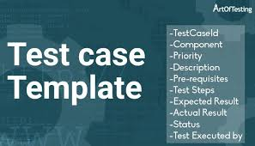

Slide 14
Why should we move from Manual to Automation Testing?
It requires more time than automated testing
It is susceptible to human errors
It is time-consuming to maintain test cases
It is costly to maintain manual testers
Earlier Feedback and Bug detection
Test Reusability

Slide 15
Automation Testing Scope
Web Automation
Mobile Automation
API Automation
Performance Testing etc

Slide 16
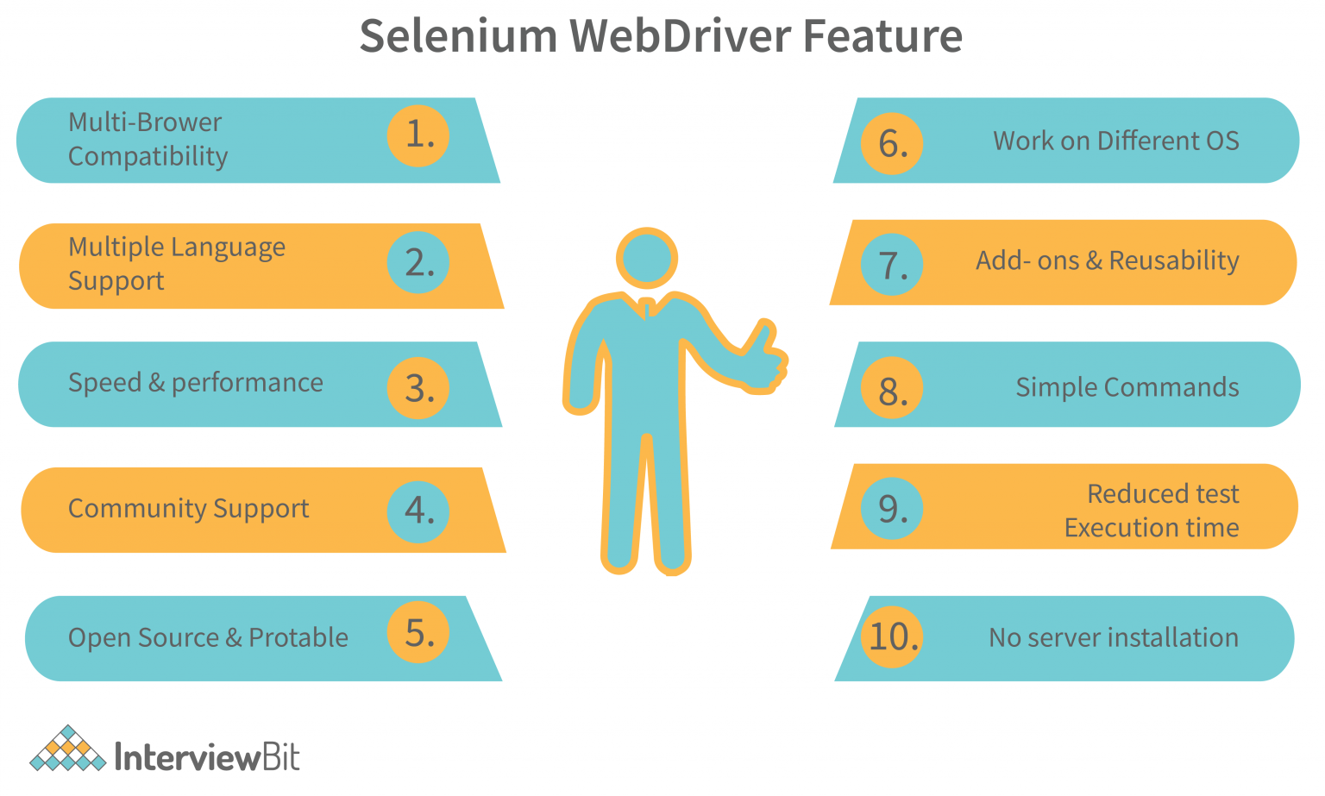
Why Selenium is Preferred for Web Automation over tools in the market?

Slide 17
Selenium Components
Selenium IDE
Selenium Webdriver
Selenium Grid

Slide 18
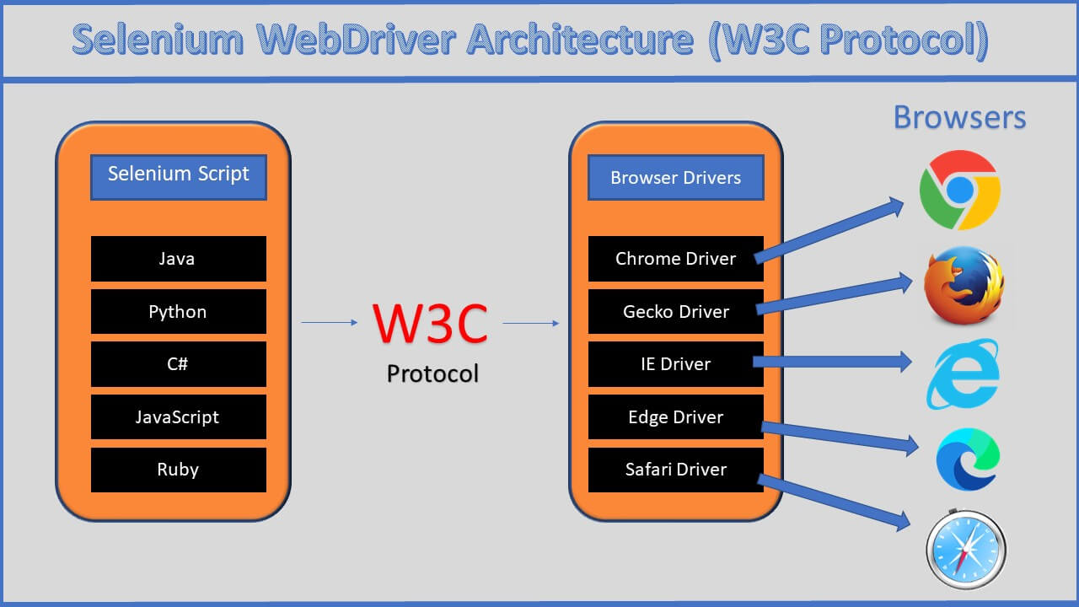
Selenium Architecture

Slide 19
Selenium Locators
Method | Syntax | Description
By ID | driver.findElement(By.id (<element ID>)) | Locates an element using the ID attribute
By name | driver.findElement(By.name (<element name>)) | Locates an element using the Name attribute
By class name | driver.findElement(By.className (<element class>)) | Locates an element using the Class attribute
By tag name | driver.findElement(By.tagName (<htmltagname>)) | Locates an element using the HTML tag

Slide 20
Selenium Locators
Method | Syntax | Description
By link text | driver.findElement(By.linkText (<linktext>)) | Locates a link using link text
By partial link text | driver.findElement(By.partialLinkText (<linktext>)) | Locates a link using the link's partial text
By CSS | driver.findElement(By.cssSelector (<css selector>)) | Locates an element using the CSS selector
By XPath | driver.findElement(By.xpath (<xpath>)) | Locates an element using XPath query

